Slide 1

Bike Planner, an extension to the Divvy app
rguthrie

Slide 2
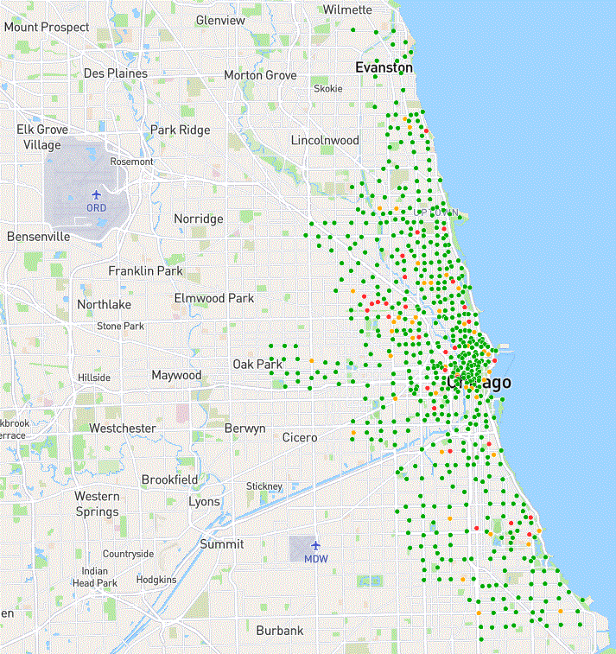
What’s DIVVY?
Divvy is the bicycle ride-sharing system in Chicago. The system comprises 600+ checkout/return stations and many, many bicycles.
Divvy is supported with an active App to show current inventory of bikes per station, and open car parking spaces.
But Divvy doesn’t tell you how much time to plan for riding from one given stations to another, given the time of day, the season of the year, and for people of your gender and age.
Enter Bike Planner! By mining 2018 and 2019 Divvy trip data, Bike Planner will give you an average trip time and route for any two stations you choose!

Slide 3
DIVVY DATABASE – 5.8M RIDES IN 2018-2019
2018 Q1
387145
2018 Q4
300 k
2019 Q1
250 k
2018 Q2
250 k
2018 Q3
500 k
2019 Q2
350 k
2019 Q3
600 k
2019 Q4
400 k
Each ride comprises:
Departure station location, date, and time
Arrival station location, date, and time
For rides by subscribed riders (the large majority), rider gender and birth year
… which is perfect for demographic, temporal, and geographic matching to new rides!

Slide 4
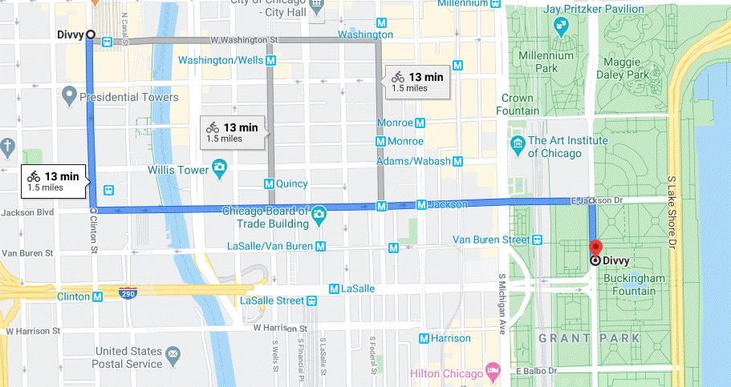
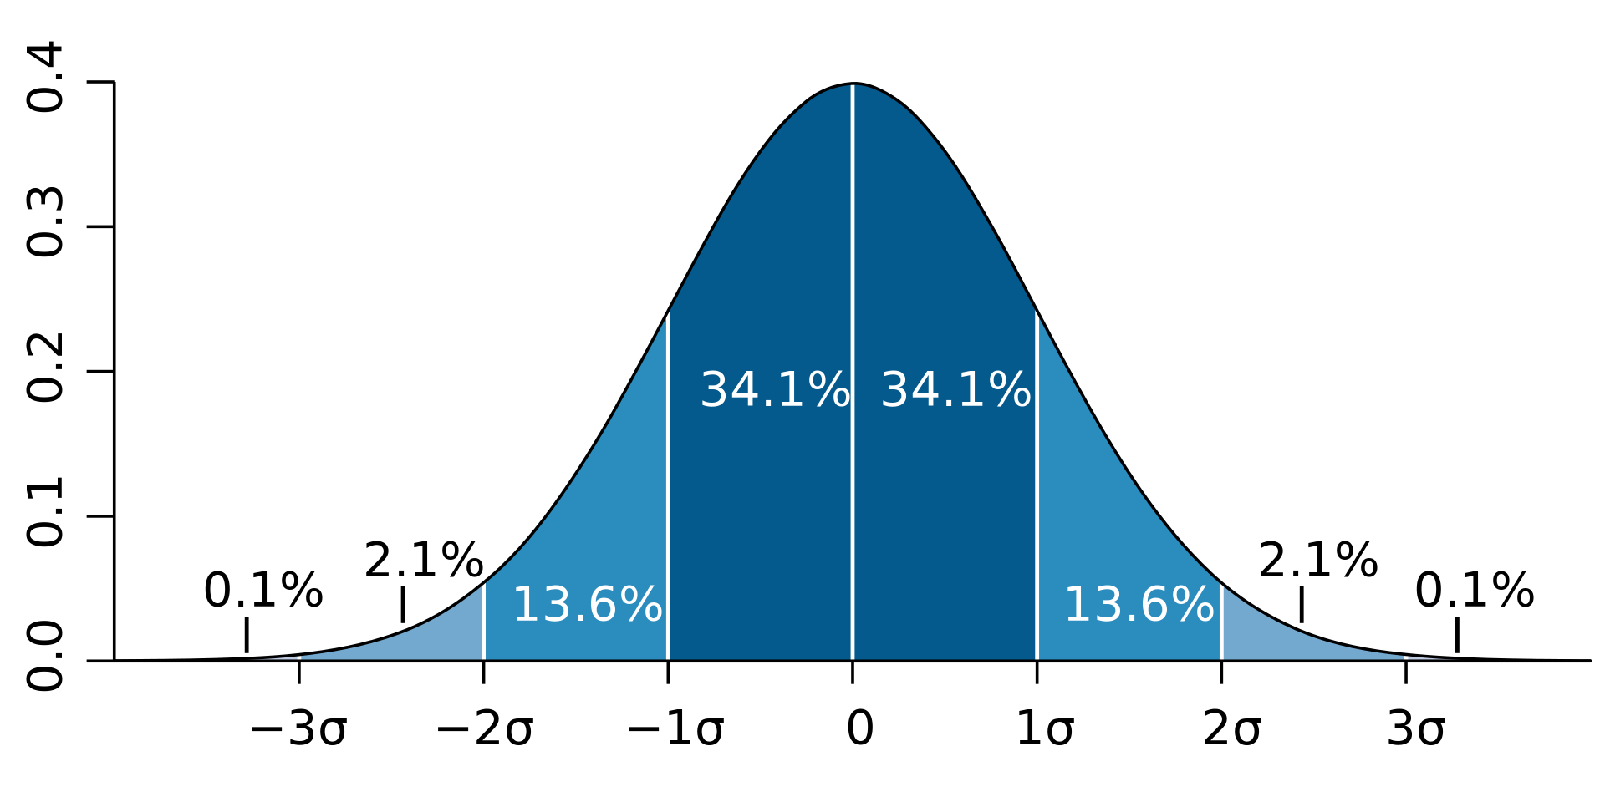
BIKE PLANNER
APIs:
Google Maps
Google Routes
Analytics:
Custom simple statistics with outlier rejection
Charting:
Chart.js package
Planned Ride:
Departure Station
Arrival Station
Date of Ride
Time of Ride
Rider Gender
Rider Age

